Slide 1


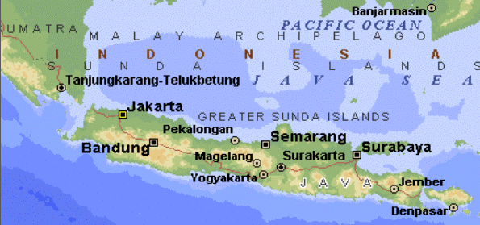
Web Services
Written by Liron Blecher

Slide 2
Agenda
JEE, JEE Containers
What are Web Services
Big Web Service
Metro
REST

Slide 3
JEE – Java Enterprise Edition
In most organizations most programs use the client/server paradigm (also true for Web Applications).
Instead of implementing servers and communication protocols for every project, Java EE specifies sets of APIs for most servers related tasks (communication, DB, messaging, etc.)
Some of these APIs are implemented as Libraries and some as Programs

Slide 4
JEE – JEE Containers
One API is known as JEE Container (or Web Container or Servlet Container).
This is a specification for a Web Server that can also runs Java Code.
There are different implementations of JEE Container – Apache Tomcat, Glassfish, JBoss (and more…).
It’s actually more complicated than this… but let’s keep it simple for now

Slide 5
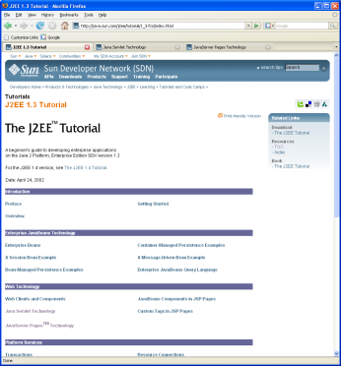
JEE – Tomcat
Tomcat is a JEE Servlet Container.
It can run regular web sites but also Java code.
Just like any other web server it handles the HTTP protocol (requests and responses).
Servlet
request
request
response
response
request
HTML
Web browser
Tomcat
response

Slide 6
Agenda
JEE, JEE Containers
What are Web Services
Big Web Service
Metro
REST

Slide 7
Web Services Links
Java EE 6 Tutorial on Web Services http://docs.oracle.com/javaee/6/tutorial/doc/gijti.html
Tomcat http://tomcat.apache.org/download-70.cgi
Metro https://metro.java.net/

Slide 8
What is a Web Service
A Web Service is any server application that:
Is available over the web/HTTP
Is OS and Programming language independent

Slide 9
Web Service Roles
There are three major roles
Service
Registry
2) Discover services
Logically Centralized directory of services
1) Register service
Service
Requestor
Service
Provider
3) Invoke service
Consumer of the Web Service
Provider of the Web Service

Slide 10
Types of Web Services
Web services can be implemented in various ways. The two most popular methods of implementation are:
Big web services
RESTful web services

Slide 11
Big Web Services
Big web services use XML messages that follow the Simple Object Access Protocol (SOAP) standard, an XML language defining a message architecture and message formats.
Such systems often contain a machine-readable description of the operations offered by the service, written in the Web Services Description Language (WSDL), an XML language for defining interfaces syntactically.
In Java EE 6, JAX-WS provides the functionality for “big” web services.

Slide 12
RESTful Web Services
RESTful web services (Representational State Transfer) use existing well-known W3C standards (HTTP, XML, URI, MIME) and have a lightweight infrastructure that allows services to be built with minimal tooling.
Developing RESTful web services is inexpensive and thus has a very low barrier for adoption.
REST is well suited for basic scenarios. RESTful web services better integrated with HTTP than SOAP-based services are, do not require XML messages or WSDL service–API definitions.
In Java EE 6, JAX-RS provides the functionality for RESTful web services.

Slide 13
Agenda
JEE, JEE Containers
What are Web Services
Big Web Service
Metro
REST

Slide 14
Big Web Service - Protocol Stack
Description | Protocol | Role
Responsible for centralizing services | UDDI | Discovery
Responsible for describing the public interface to a specific web service | WSDL | Description
Responsible for encoding messages in common XML format | SOAP | XML Messaging
Responsible for transporting messages | HTTP/S | Transport

Slide 15
Big Web Service - SOAP
What is SOAP?
Simple Object Access Protocol
Is a protocol that uses XML messages to perform RPC (Remote Procedure Calls), meaning, call a function on another (usually remote) program
Requests are encoded in XML and send via HTTP
Responses are encoded in XML and received via HTTP

Slide 16
Big Web Service - SOAP Message
SOAP Message
Envelope is like a wrapper for content
Header is a optional element that could contain control information
Body element includes requests and responses
Body element can also include a Fault element in case of an error
Envelope
Header
Body

Slide 17
Big Web Service - Sample SOAP Request
<SOAP-ENV:Envelope
xmlns:xsd="http://www.w3.org/2001/XMLSchema"
xmlns:SOAP-ENV=http://schemas.xmlsoap.org/soap/envelope/
xmlns:xsi="http://www.w3.org/2001/XMLSchema-instance">
<SOAP-ENV:Body>
<ns1:sayHello
xmlns:ns1="http://agram.com/">
<name xsi:type="xsd:string">Java</name>
</ns1:sayHello>
</SOAP-ENV:Body>
</SOAP-ENV:Envelope>

Slide 18
Big Web Service - Sample SOAP Response
<SOAP-ENV:Envelope
xmlns:xsd="http://www.w3.org/2001/XMLSchema"
xmlns:SOAP-ENV=http://schemas.xmlsoap.org/soap/envelope/
xmlns:xsi="http://www.w3.org/2001/XMLSchema-instance">
<SOAP-ENV:Body>
<ns1:sayHelloReponse
xmlns:ns1="http://agram.com/">
<result xsi:type="xsd:string">Hello Java</result>
</ns1:sayHelloResponse>
</SOAP-ENV:Body>
</SOAP-ENV:Envelope>

Slide 19
Big Web Service - WSDL
What is WSDL?
Web Services Description Language
Has 6 major elements:
Definitions – defines the name of the web service
Types – describes all the data types that will be transmitted
Message – defines the name of the message that will be transmitted
PortType – defines the operations
Binding – defines how the message will be transmitted
Service – defines where the service is located

Slide 20
Development plan for Service Requestor
1) Find web service via UDDI
2) Retrieve service description file
3) Create XML-RPC or SOAP client
4) Invoke remote service

Slide 21
Development plan for Service Provider
1) Create the core functionality
2) Create XML-RPC or SOAP service wrapper
3) Create service description file
4) Deploy service
5) Register new service via UDDI

Slide 22
Agenda
JEE, JEE Containers
What are Web Services
Big Web Service
Metro
REST

Slide 23
What is Metro
JAX-WS is a specification of which Classes, Interfaces, Annotations and behaviors a JEE Application should have in order to support Big Web Services in Java.
The standard JDK does NOT contain an implementation of these classes (or even the classes themselves).
Metro is one of several implementations of the JAX-WS specification (another implementation for example is Apache Axis).
Metro homepage is https://metro.java.net/

Slide 24
What is Metro – cont’
So what is Metro?
Metro is a Java Library (or Service Stack) that implements the JAX-WS specification.
It allows developers to create JAX-WS compatible servers and clients without the need to write code that parses and formats SOAP messages.
It also includes tools for generating services from given WSDL files.

Slide 25

What is Metro – cont’
Source: http://docs.oracle.com/javaee/6/tutorial/doc/bnayn.html

Slide 26
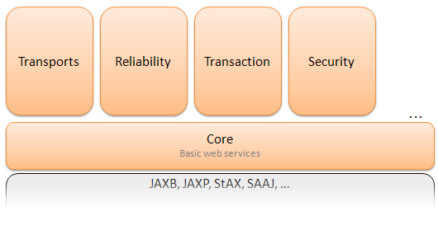
Architecture of Metro
Source: https://metro.java.net/discover/

Slide 27
Agenda
JEE, JEE Containers
What are Web Services
Big Web Service
Metro
REST

Slide 28
What is RESTful Web Service
A RESTful Web Service is a Web Service that binds the HTTP methods (GET, POST, DELETE & PUT) to server methods.
In this manner, there is no need to send XML messages since the basic methods are already defined in the HTTP protocol.
It is usually used to expose a CRUD (Create, Read, Update and Delete) functionality of the server.
The parameters of an HTTP request are used as parameters for the server methods.

Slide 29
What is Jersey
Just like Metro is the implementation of the JAX-WS specification, Jersey, is the implementation of the JAX-RS specification.
Project Jersey is the production-ready reference implementation for the JAX-RS specification.
Jersey implements support for the annotations defined in the JAX-RS specification, making it easy for developers to build RESTful web services with Java.

Slide 30
Agenda
JEE, JEE Containers
What are Web Services
Big Web Service
Metro
REST
Appendix 1 – Tomcat in Netbeans
Appendix 2 – Web Service App
Appendix 3 – Web Service Client

Slide 31
Appendix 1 – Tomcat in Netbeans
Download Tomcat
Go to http://tomcat.apache.org/download-70.cgi
Choose either 32-bit Windows zip or 64-bit Windows zip (for any other platform choose plain zip)
Do NOT choose 32-bit/64-bit Windows Service Installer
Extract the downloaded file into your root directory (c:\)
Do NOT extract Tomcat to your Desktop or Documents folder

Slide 32
Appendix 1 – Tomcat in Netbeans
Set your JAVA_HOME and JRE_HOME: http://stackoverflow.com/questions/2619584/how-to-set-java-home-on-windows-7
Check that Tomcat is running by going to your Tomcat bin folder and load startup.bat – then open a browser and go to http://localhost:8080
If you see the Tomcat home page then your installation was successful
Add Tomcat to Netbeans (see next slides)

Slide 33
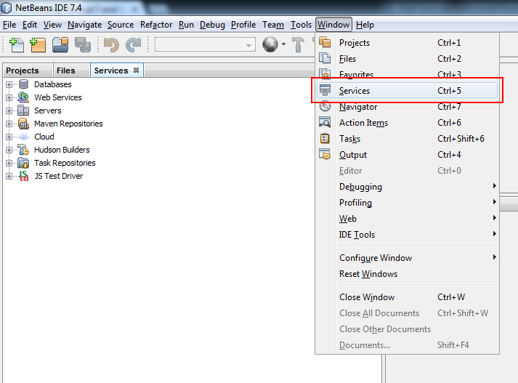
Appendix 1 – Tomcat in Netbeans

Slide 34
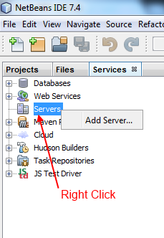
Appendix 1 – Tomcat in Netbeans

Slide 35
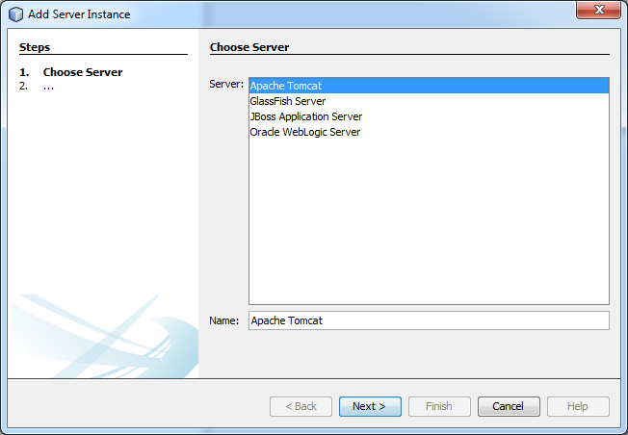
Appendix 1 – Tomcat in Netbeans

Slide 36
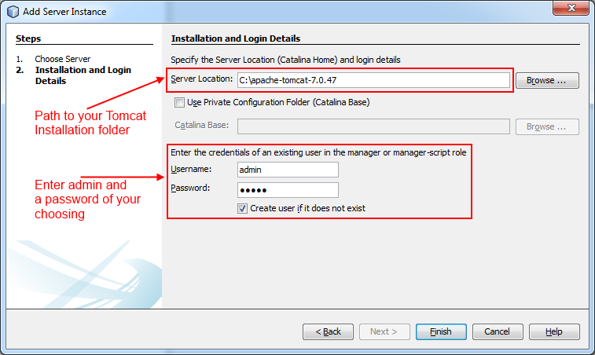
Appendix 1 – Tomcat in Netbeans

Slide 37
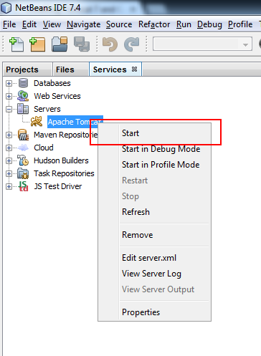
Appendix 1 – Tomcat in Netbeans

Slide 38
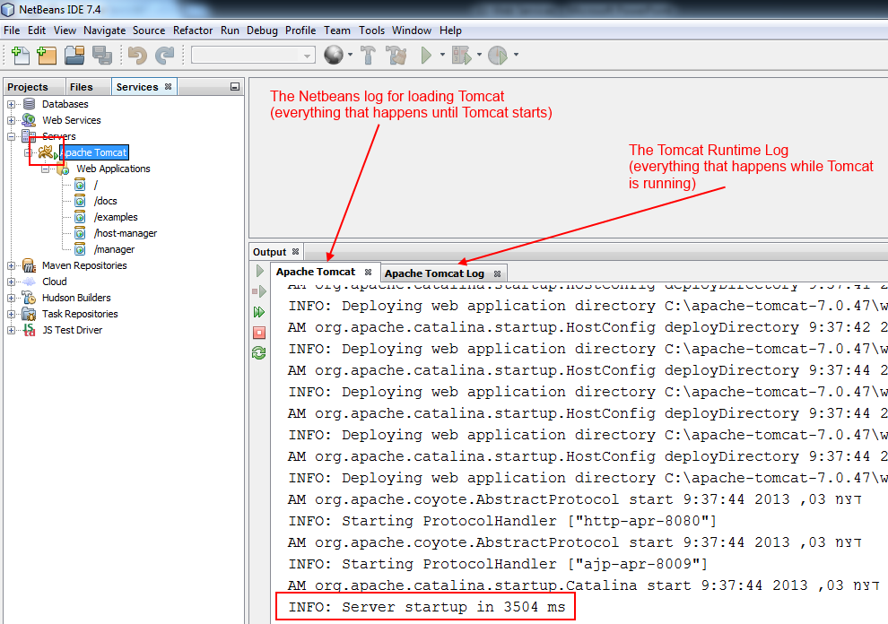
Appendix 1 – Tomcat in Netbeans

Slide 39
Agenda
JEE, JEE Containers
What are Web Services
Big Web Service
Metro
REST
Appendix 1 – Tomcat in Netbeans
Appendix 2 – Web Service App
Appendix 3 – Web Service Client

Slide 40
Appendix 2 – Create a Web Service Application
Create a new Web Application Project
Create a new Web Service
Deploy your WebApp Project to Tomcat

Slide 41
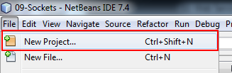
Appendix 2 – Create a Web Service Application

Slide 42
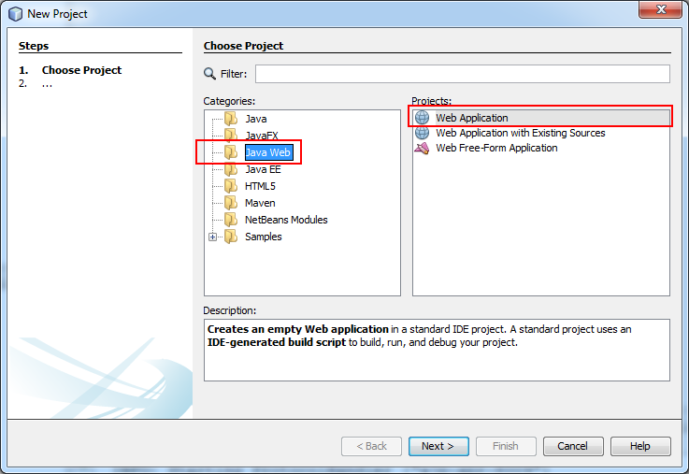
Appendix 2 – Create a Web Service Application

Slide 43
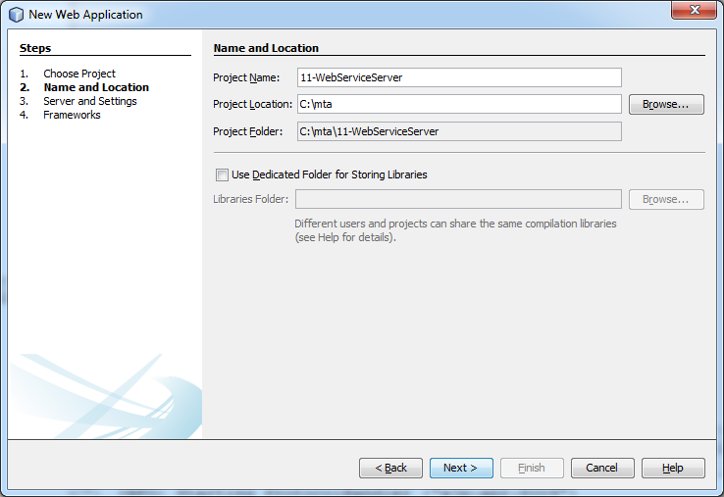
Appendix 2 – Create a Web Service Application

Slide 44
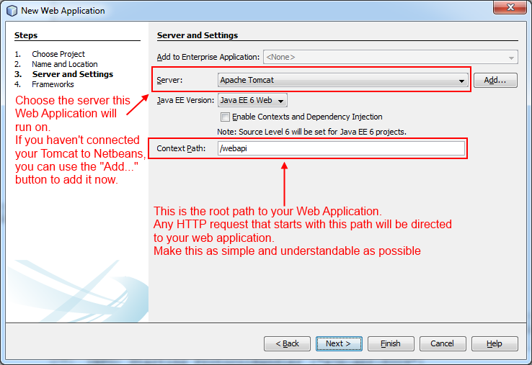
Appendix 2 – Create a Web Service Application

Slide 45
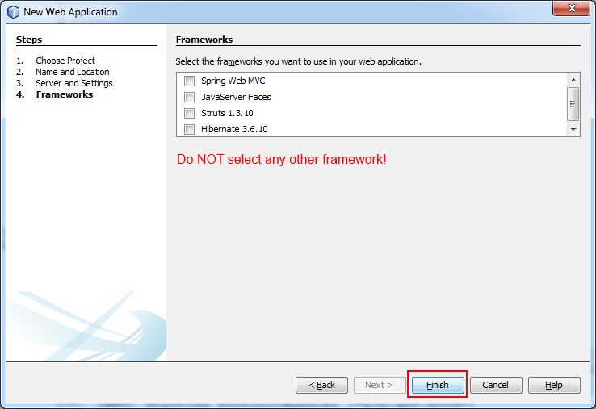
Appendix 2 – Create a Web Service Application

Slide 46
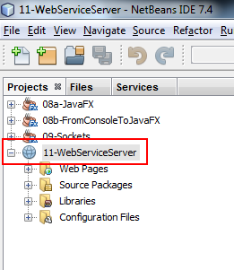
Appendix 2 – Create a Web Service Application

Slide 47

Appendix 2 – Create a Web Service Application

Slide 48
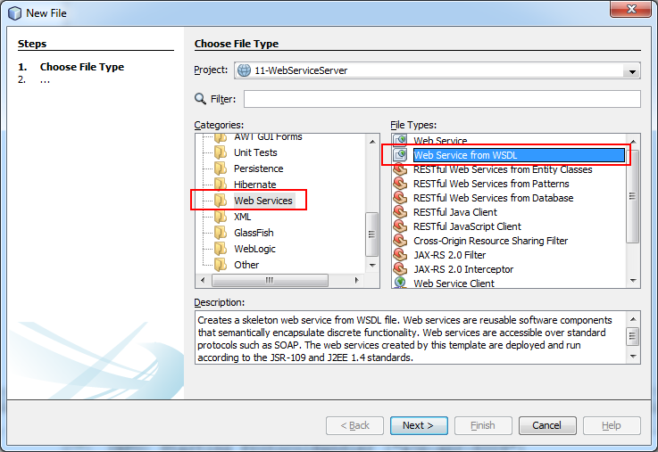
Appendix 2 – Create a Web Service Application

Slide 49
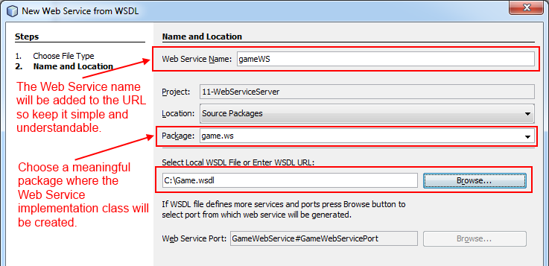
Appendix 2 – Create a Web Service Application

Slide 50
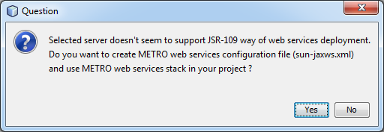
Appendix 2 – Create a Web Service Application

Slide 51
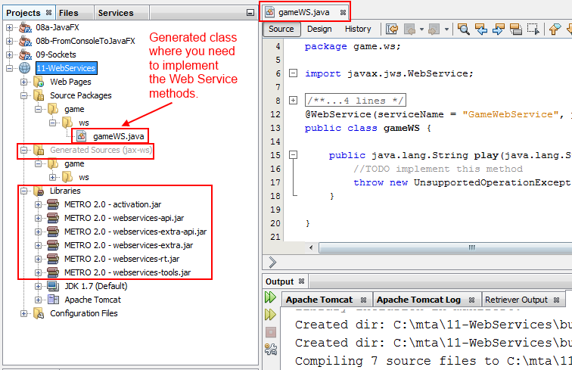
Appendix 2 – Create a Web Service Application

Slide 52
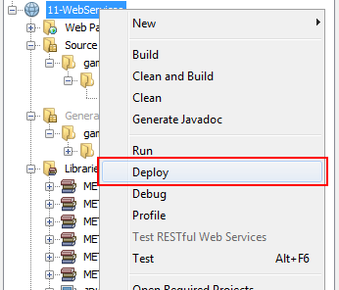
Appendix 2 – Create a Web Service Application

Slide 53
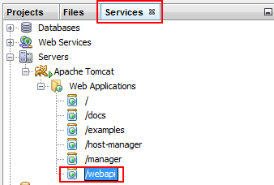
Appendix 2 – Create a Web Service Application

Slide 54
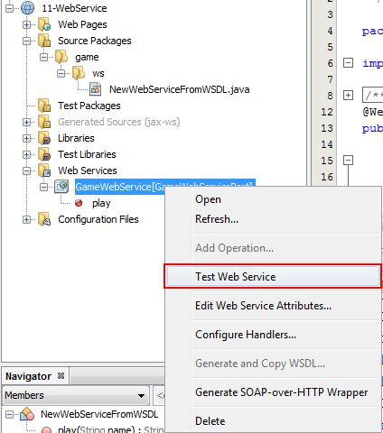
Appendix 2 – Create a Web Service Application

Slide 55
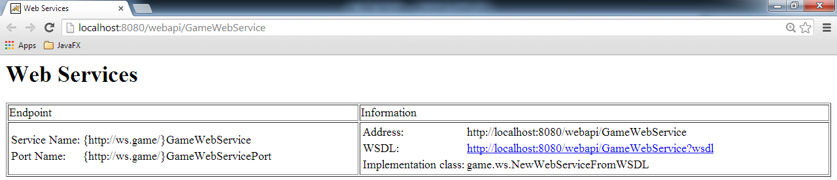
Appendix 2 – Create a Web Service Application

Slide 56
Agenda
JEE, JEE Containers
What are Web Services
Big Web Service
Metro
REST
Appendix 1 – Tomcat in Netbeans
Appendix 2 – Web Service App
Appendix 3 – Web Service Client

Slide 57

Appendix 3 – Create a Web Service Client

Slide 58
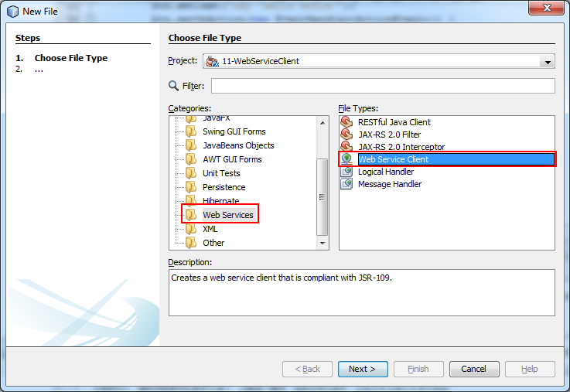
Appendix 3 – Create a Web Service Client

Slide 59
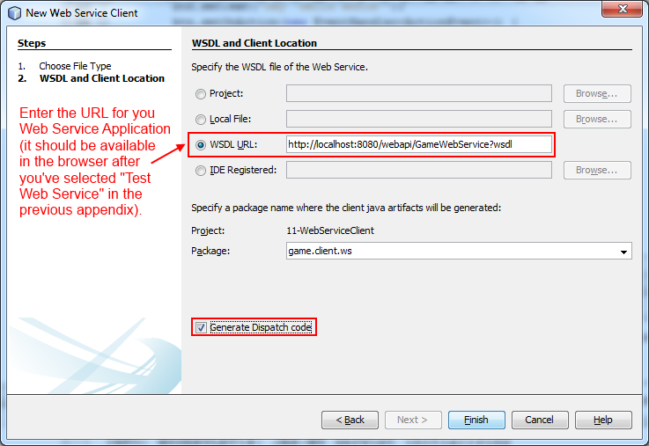
Appendix 3 – Create a Web Service Client

Slide 60
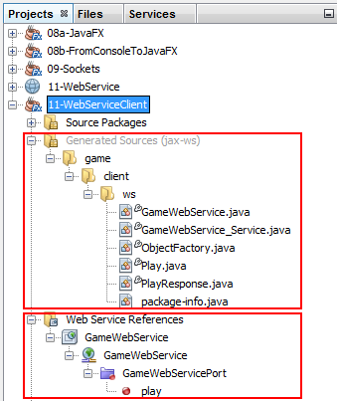
Appendix 3 – Create a Web Service Client

Slide 61
Appendix 3 – Create a Web Service Client
The code needed to initialize the Web Service Client:
//create a new service
GameWebService_Service service = new GameWebService_Service();
//get the port
GameWebService gameWebService = service.getGameWebServicePort();
//call methods on the server
gameWebService.play("Some test string...");

